Slide 1
TAFL
TM

Slide 2
The Standard Turing Machine
The TM has a tape that is unbounded in both directions, allowing any number of left and right moves
The TM is deterministic in the sense that δ defines at most one move for each configuration.
No special input file and no special output device. Only tape!

Slide 3
Turing Thesis
According to Alan Turing "Any problem for which algorithm exists, turing machine will exist for that problem."
Anything that can be performed by existing digital computer can also done by using Turing Machine.
This is a hypothesis because noone has come up with a problem solvable by algorithm for which a Turing Machine cannot be written.
And from 1930 till today nobody is able to prove that Turing Thesis is wrong.
Turing Machine is accepted as definition of "mechanical computation" or "Computer".

Slide 4
Turing Thesis Correctness
To prove Turing Thesis either take all the programs(number of programs are infinite) which exists and design Turing Machine for every program, which is a very tedious task or one should come up with a problem for which an algorithm exists but Turing Machine cannot be written.
But later did not happen till date and there are very few chances that someone can do that.

Slide 5
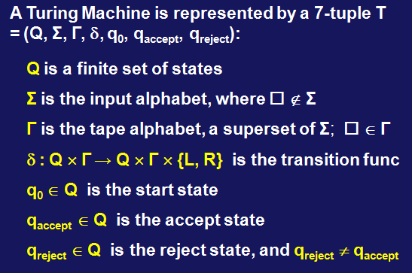

TM Components
∆
∆

Slide 6
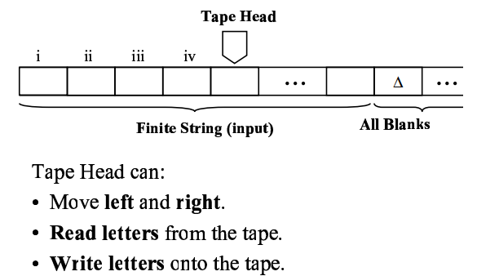
Turing Machine

Slide 7
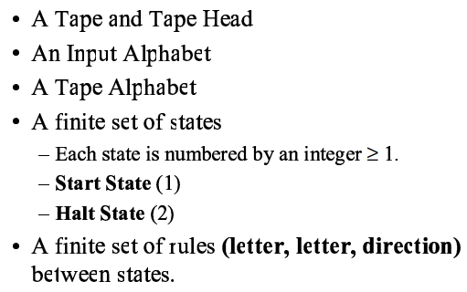
TM Components

Slide 8
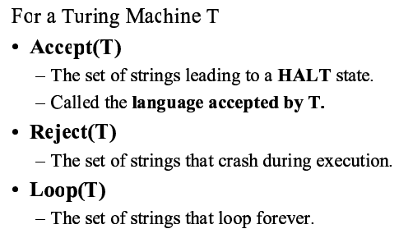
Definitions

Slide 9
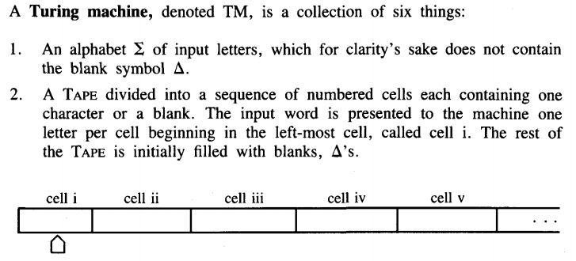
Turing Machine

Slide 10
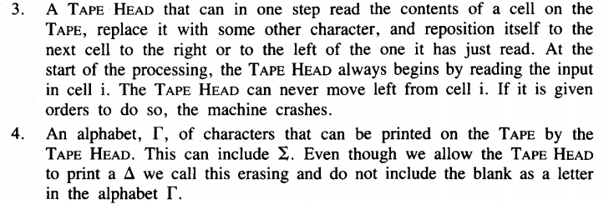
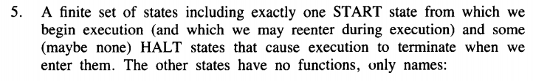
Turing Machine

Slide 11
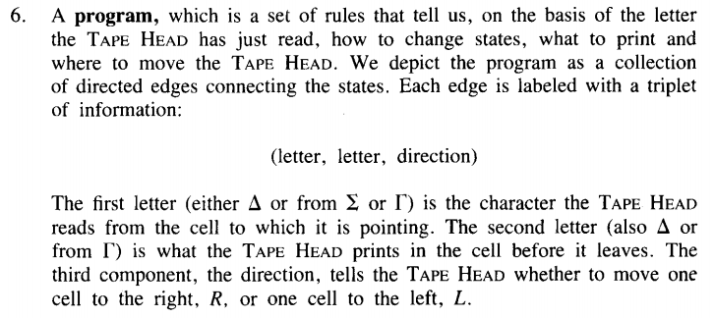
Turing Machine

Slide 12
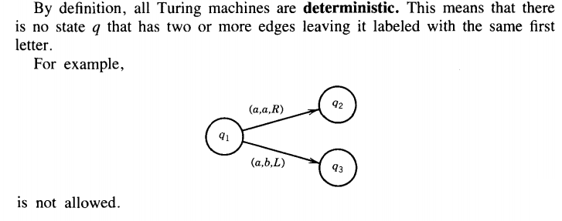
Turing Machine

Slide 13
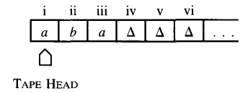
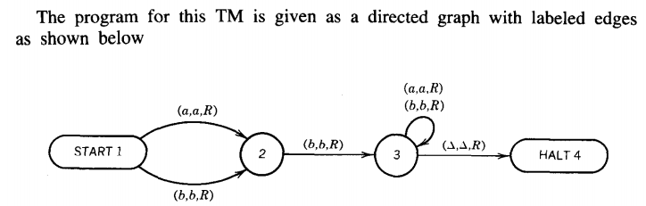
Example

Slide 14
FA That Accepts double aa
Try it

Slide 15
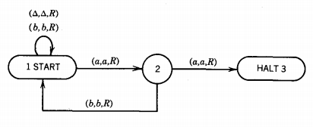
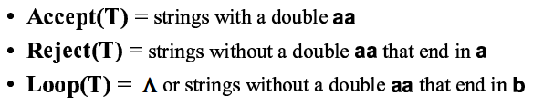
TM that accepts double a

Slide 16
Turing machine as transducer for 1's complement
Turing machine can work as Transducer as well as Acceptor.
Transducer
When input is converted into output.
Acceptor
When it is decided that whether string belongs to language or not.(Answer in YES or NO). Example: DFA, PDA etc
Turing machine can read as well as write on the TAPE that is the reason it can work as TRANSDUCER.

Slide 17
Turing machine for 1's complement
Algorithm/Approach for 1's complement
Scan input string from left to right
Convert '1' into '0'
Convert '0' into '1'
When BLANK is reached move towards left(start of input string).

Slide 18
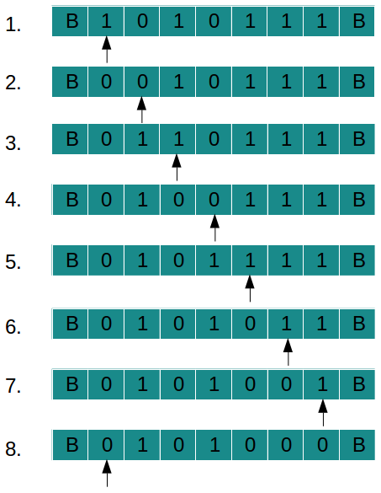
Turing machine for 1's complement
“TAPE movement
for a sample string
’1010111’ ”

Slide 19
Turing machine for 1's complement
Explanation of TAPE movement
Input is given as "1010111" (scan string from left to right)
Convert '1' into '0' and move one step right
Convert '0' into '1' and move one step right
Convert '1' into '0' and move one step right
Convert '0' into '1' and move one step right
Convert '1' into '0' and move one step right
Convert '1' into '0' and move one step right
Convert '1' into '0' and move one step right
BLANK(in right) is reached when string is finished. So move to start of string(optional).

Slide 20
Turing machine for 1's complement
1's complement is written into the TAPE in place of input string. Input String : 1010111 Output String : 0101000

Slide 21
Turing machine for 1's complement
State Transition Diagram
We have designed state transition diagram for 1's complement as follows:
1. Replace '1' with '0' and vice versa. 2. When BLANK is reached move towards left 3. Using state 'q2' we reach start of the string. 4. When we reach BLANK in left we move one step right to point start of string. 5. qf is final state

Slide 22
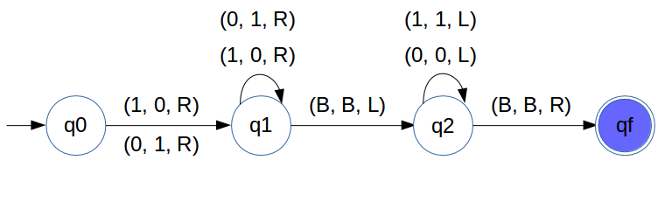
Turing machine for 1's complement

Slide 23
Turing machine for 2's complement
Algorithm/Approach
Scan input string from right to left
Pass all consecutive '0's
When '1' comes do nothing
After that take complement of every digit.

Slide 24
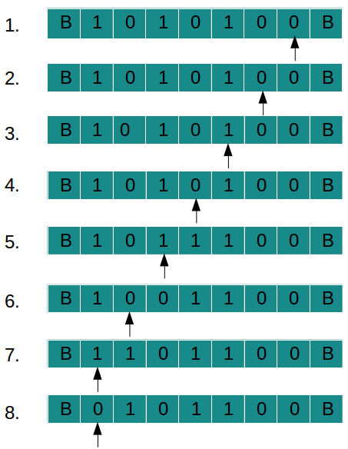
Turing machine for 2's complement
TAPE movement
for string "1010100":

Slide 25
Turing machine for 2's complement
Explanation of TAPE movement
Input is given as "1010100" (scan string from right to left)
Pass two '0's from right
Pass '1' after that
Take complement of '0' = '1'
Take complement of '1' = '0'
Take complement of '0' = '1'
Take complement of '1' = '0'
BLANK(in left) is reached when string is finished. So move to start of string(optional) by moving one step right

Slide 26
Turing machine for 2's complement
2's complement is written into the TAPE in place of input string.
Input String : 1010100
Output String : 0101100

Slide 27
Turing machine for 2's complement
State Transition Diagram
We have designed state transition diagram for 2's complement as follows: 1. Go to right of string using state q0 2. When BLANK is reached take one step left 3. Start scanning string from right to left 4. Pass all '0's and keep moving left 5. Pass single '1' and move left 6. Take complement of '1' and '0' after that. 7. When BLANK(in left) is reached move one step right and point to start of string.

Slide 28
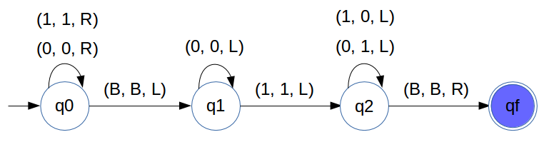
Turing machine for 2's complement

Slide 29
Turing Machine that accept a^{n}b^{n}
Simple Algorithm
Mark 'a' then move right.
Mark 'b' then move right
Come to far left till we get 'X'
Repeat above steps till all 'a', 'b‘ are marked
At last if everything is marked that means string is accepted.

Slide 30
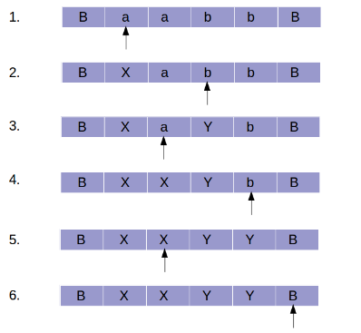
Turing Machine that accept a^{n}b^{n}
“TAPE
head
movement”

Slide 31
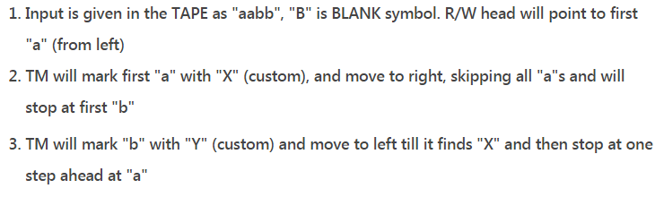
Turing Machine that accept a^{n}b^{n}
Now we will explain the logic step by step:

Slide 32
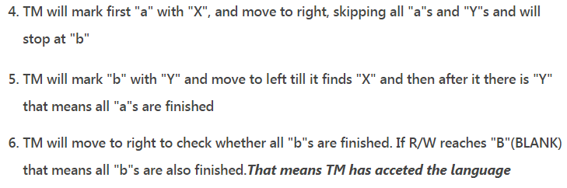
Turing Machine that accept a^{n}b^{n}
Now we will explain the logic step by step:

Slide 33
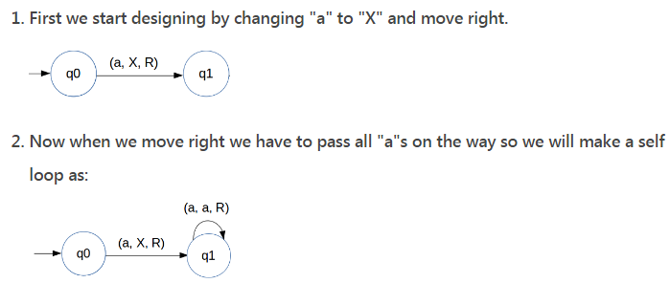
Turing Machine that accept a^{n}b^{n}
Now we will see how to design State Transition Diagram of Turing Machine for above problem:

Slide 34
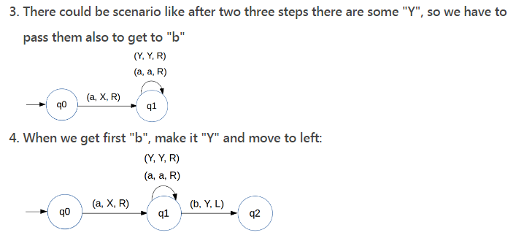
Turing Machine that accept a^{n}b^{n}

Slide 35
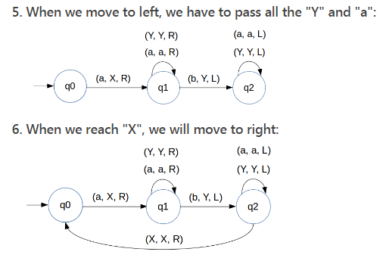
Turing Machine that accept a^{n}b^{n}

Slide 36
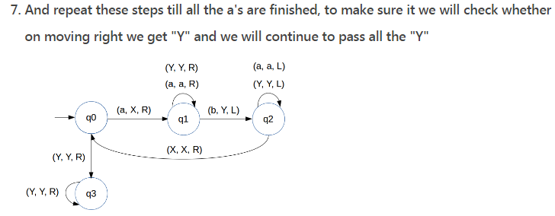
Turing Machine that accept a^{n}b^{n}

Slide 37
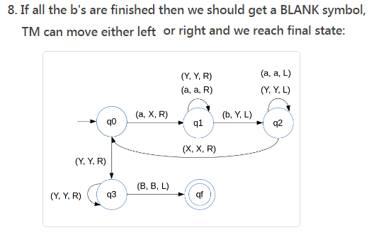
Turing Machine that accept a^{n}b^{n}
Notes:
aaaabbbb
XaaaYbbb
XXaaYYbb
XXXaYYYb
XXXXYYYY Accept
1)aaaaabbbbb accept
2)aaaaabbbb
3)Aaaabbbbb
a^n.b^m.c^p, please try this machine where n=m=p

Slide 38
Turing Machine that accept a^{n}b^{n}c^{n}
Simple Algorithm
Mark 'a' then move right.
Mark 'b' then move right
Mark 'c' then move left
Come to far left till we get 'X'
Repeat above steps till all 'a', 'b' and 'c' are marked
At last if everything is marked that means string is accepted.

Slide 39
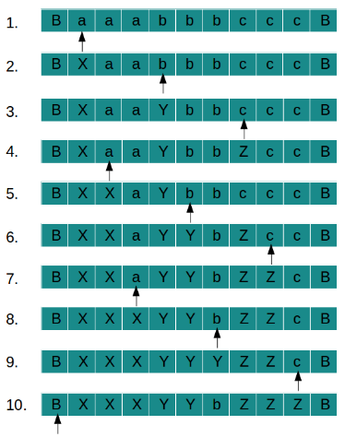
Turing Machine that accept a^{n}b^{n}c^{n}
Sample String: TAPE movement for string "aaabbbccc":

Slide 40
Construct TM for given language
0^n.1^n.2^n

Slide 41
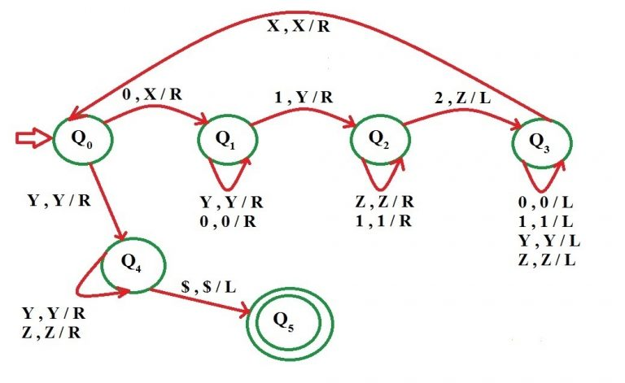
TM for 0^n.1^n.2^n

Slide 42
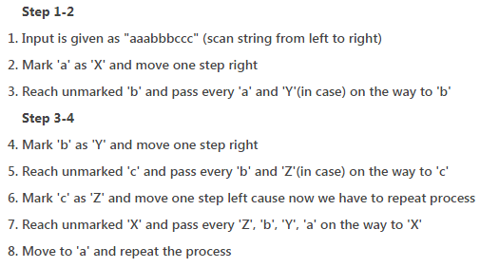
Explanation of TAPE movement

Slide 43
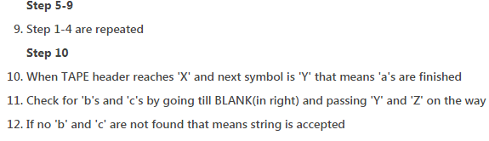
Explanation of TAPE movement

Slide 44
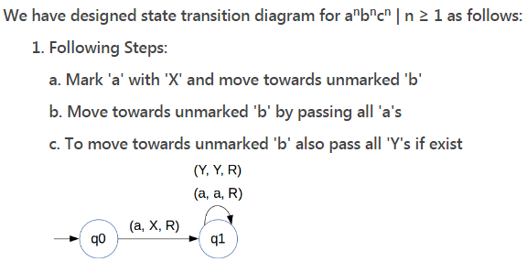
State Transition Diagram

Slide 45
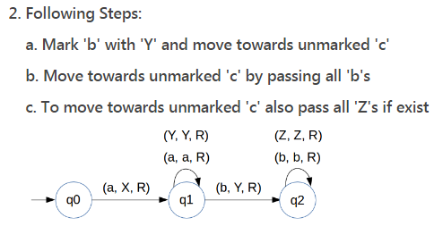
State Transition Diagram

Slide 46
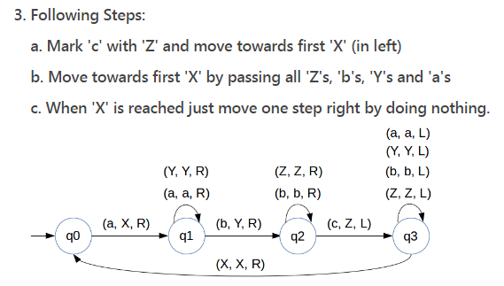
State Transition Diagram

Slide 47

State Transition Diagram

Slide 48
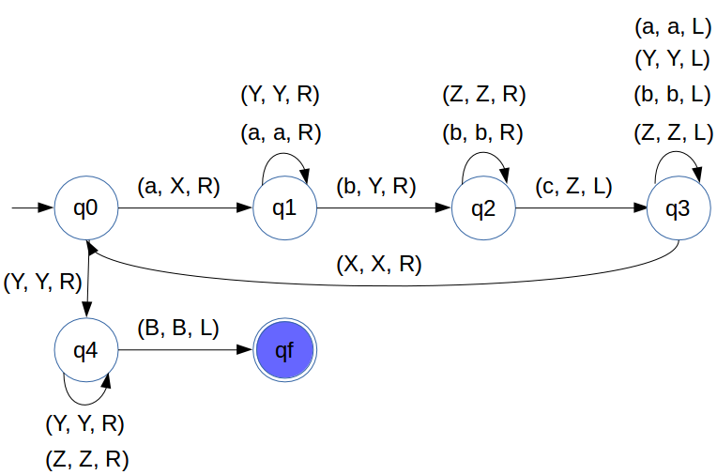
State Transition Diagram : a^{n}b^{n}c^{n}

Slide 49

Turing Machine that accept 0^{n}1^{n}
Change “0” to “X”
Move Right to first “1”
If none: REJECT
Change “1” to “Y”
Move Left to leftmost “0”
Repeat the above steps until no more “0”s
Make sure no more “1”s remain

Slide 50
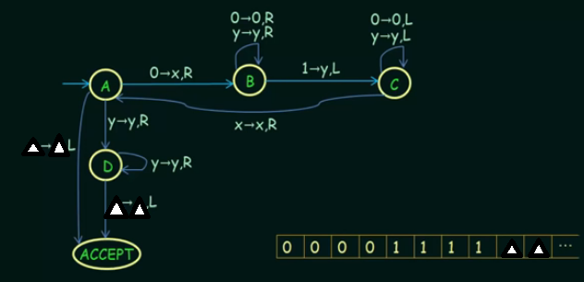
Turing Machine that accept 0^{n}1^{n}

Slide 51
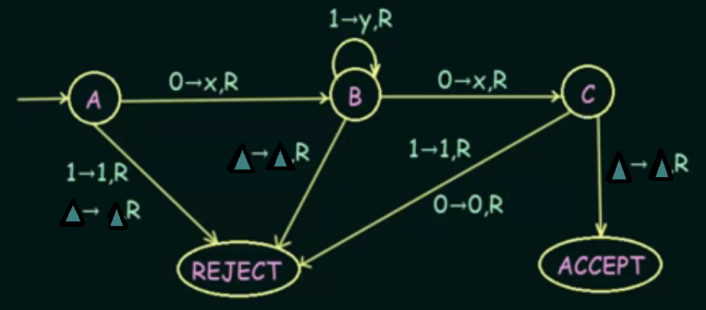
Turing Mahine that accept 01*0
Notes:
00
010
0111110
011
01101
01100

Slide 52
Sample Strings
00 accept
010 accept
0111110 accept
011 reject
01101 reject
01100 reject

Slide 53
Turing Machine that accept 01*0
Sample String acceptance for this language
X | Y | Y | X | Δ | Δ | Δ | Δ

Slide 54

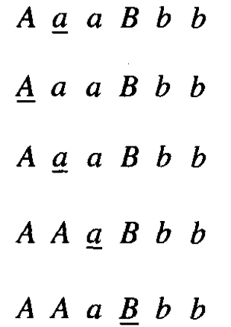
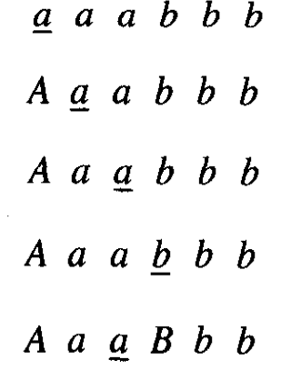
Example: A TM that accept

Slide 55
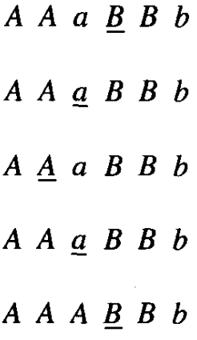
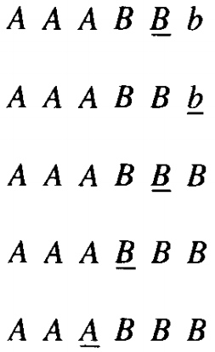
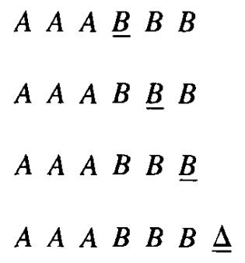
Example: A TM that accept

Slide 56
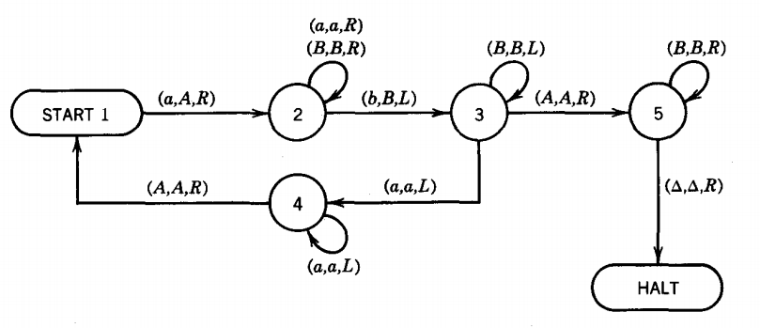
TM of

Slide 57
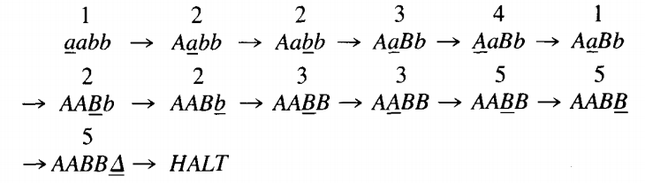
aabb string state wise

Slide 58
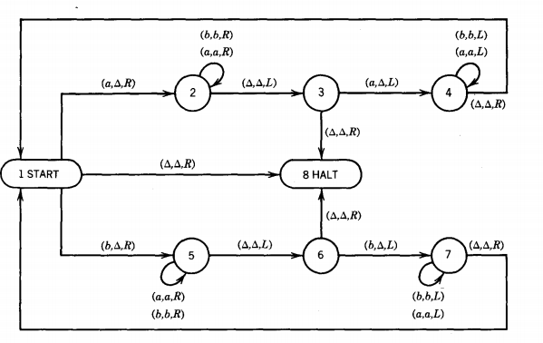
TM for palindrome

Slide 59
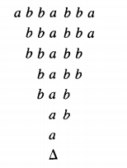
TM for palindrome (abbabba)

Slide 60
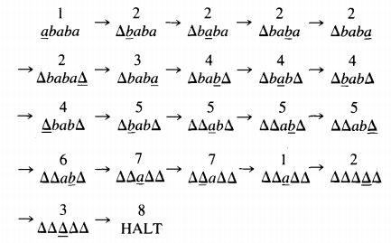
ababa string state wise

Slide 61
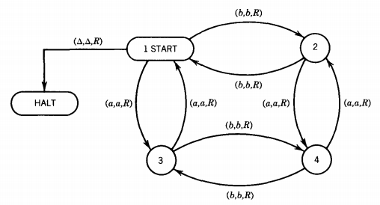
TM to accept the language EVEN-EVEN
Test any sample string from this machine

Slide 62
TM that accepts double a
Test any sample string from this machine

